Slide 1


Adapting Large Language Models for Personalized Impression Generation in PET reports: Expert Evaluation
Xin Tie MS, Muheon Shin MD, Ali Pirasteh MD, Ibrahim Nevein MD, Zachary Huemann MS,
Junjie Hu PhD, Steve Y. Cho MD, Tyler J. Bradshaw PhD
Department of Radiology, University of Wisconsin, Madison, WI

Slide 2

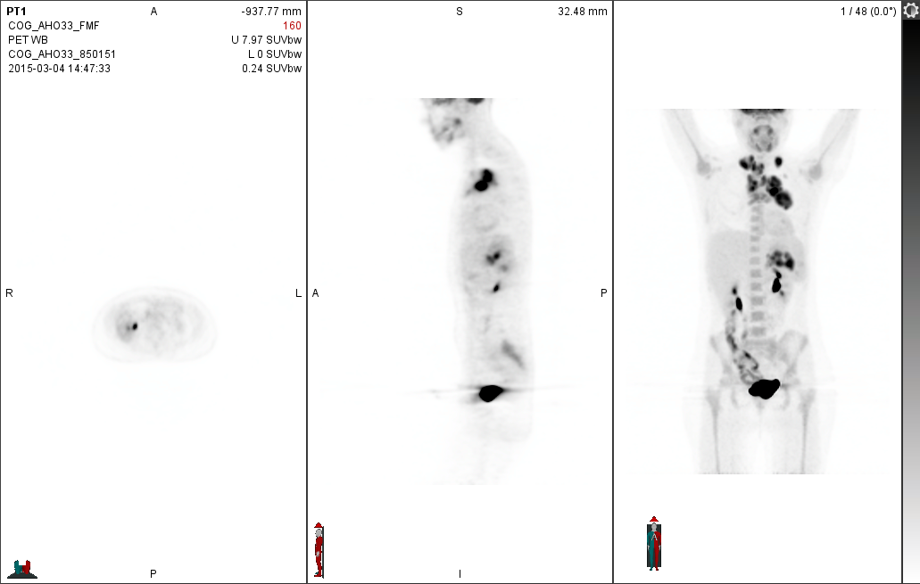


Introduction: Radiology Report
EXAM: PET CT SKULL BASE TO THIGH.
HISTORY: New diagnosis of lymphoma, 3-week history of cough, fevers, night sweats, and 8-pound weight loss.
TECHNIQUE: In a rested and fastir state, the patient was injected with F-18 FDG. The patient was imaged after an approximate 1 hour uptake phase delay using a dedicated dual modality PET/CT scanner with concurrent noncontrast CT scan data acquisition used for anatomic correlation and coregistration, and for attenuation eorvection. Images were processed with and without attenuation correction and with the generation of standardized uptake values (SUVs) as appropriate. The study is reviewed with the CT images, PBT images and the fused PEL/CT images presented in the standard three projections, along with the MIP 3-D rotational images.
COMPARISON: [DATE] neck and chest CT, [DATE] mediastinal mass biopsy
FINDINGS:
Skull base/neck: Probable physiologic activity is noted in the nasopharynx. Uptake in the floor of the mouth may be related to artifact from dental hardware. Hypermetabolic nodes are present in both supraclavicular regions, contiguous with superior mediastinal adenopathy.
Chest: There is bilateral hypermetabolic mediastinal lymphadenopathy. For reference, the largest left prevascular mass of confluent adenopathy has a maximum SUV of 13.6. No hypermetabolic hilar adenopathy is identified. No lung lesions are identified. No hypermetabolic axillary nodes.
Abdomen/pelvis/proximal thighs: Clustered hypermetabolic masses are noted in the left upper quadrant at the level of the splenic hilum and adjacent to the stomach and pancreatic tail. Maximum SUV is 12.5. There is presumed physiologic activity along both renal collecting systems and ureters and bladder as well as in the ascending colon. Activity in the right retroperitoneum is at the level of the mid ureter and is favored to be ureteral in origin. Small soft tissue densities are noted on noncontrast CT images in the retroperitoneum, suspicious for adenopathy; however, they are not hypermetabolic.
Musculoskeletal: No focal hypermetabolic lesions are identified in the visualized portions of the skeleton.
IMPRESSIONS:
[1] Intensely hypermetabolic superior mediastinal and bilateral supraclavicular adenopathy.
[2] Intensely hypermetabolic clustered lymph nodes in the region of the splenic hilum.
[3] Non-hypermetabolic retroperitoneal adenopathy is suspected. Correlation with a diagnostic CT of the abdomen and pelvis with IV and oral contrast is recommended.
Healthcare Team
Reading Physician
Radiological
Examination
Patient
Radiology Report
Notes:
The radiology report serves as the official interpretation of a radiological examination. It is essential for communicating relevant clinical findings among reading physicians, patients and the healthcare team. I believe many of you are quite familiar with radiology reports. Today, we will focus on a specific type of report.

Slide 3
Introduction: Clinical Whole-body PET Reports
BACKGROUND INFORMATION
[AGE] years old patient with Gleason 3+4 prostate adenocarcinoma diagnosed in [DATE]. Patient is referred for initial staging.
Report for a PET/CT skull base to thigh exam
Notes:
That is clinical whole-body PET reports. In a PET report, you will find the following sections: the background section which includes the patient’s medical history and the reason for the examination,

Slide 4
Introduction: Clinical Whole-body PET Reports
BACKGROUND INFORMATION
[AGE] years old patient with Gleason 3+4 prostate adenocarcinoma diagnosed in [DATE]. Patient is referred for initial staging.
FINDINGS
Physiologic background liver standardized uptake value (...)
Visualized head/neck: Physiologic uptake of the lacrimal and salivary glands. (...)
Head / neck lymph nodes: No suspicious head/neck lymph nodes.
Chest: No lung nodules or abnormal uptake. No pleural or pericardial effusion. (...)
Hepatobiliary: No abnormal uptake. Photogenic left hepatic cyst. (...)
Spleen / pancreas / adrenals: No abnormal splenic uptake. (...)
Kidneys / bladder: No abnormal uptake. (...)
Bowel / peritoneum: No suspicious bowel uptake or abnormality. (...)
Pelvic organs: Bilateral foci of uptake bilaterally in the peripheral zone of the prostate, (...)
Abdominopelvic lymph nodes: No definitive suspicious abdominopelvic lymph nodes. (...)
Musculoskeletal / soft tissues / skin: No suspicious lesions. (...)
Report for a PET/CT skull base to thigh exam
Notes:
the findings section which details numerous observations about the study.

Slide 5
Introduction: Clinical Whole-body PET Reports
BACKGROUND INFORMATION
[AGE] years old patient with Gleason 3+4 prostate adenocarcinoma diagnosed in [DATE]. Patient is referred for initial staging.
FINDINGS
Physiologic background liver standardized uptake value (...)
Visualized head/neck: Physiologic uptake of the lacrimal and salivary glands. (...)
Head / neck lymph nodes: No suspicious head/neck lymph nodes.
Chest: No lung nodules or abnormal uptake. No pleural or pericardial effusion. (...)
Hepatobiliary: No abnormal uptake. Photogenic left hepatic cyst. (...)
Spleen / pancreas / adrenals: No abnormal splenic uptake. (...)
Kidneys / bladder: No abnormal uptake. (...)
Bowel / peritoneum: No suspicious bowel uptake or abnormality. (...)
Pelvic organs: Bilateral foci of uptake bilaterally in the peripheral zone of the prostate, (...)
Abdominopelvic lymph nodes: No definitive suspicious abdominopelvic lymph nodes. (...)
Musculoskeletal / soft tissues / skin: No suspicious lesions. (...)
IMPRESSION
[1] Bilateral focal of uptake in the prostate consistent with known adenocarcinoma.
[2] No definitive evidence for metastatic disease. Several foci of uptake in the region of the lower lumbar spine, are favored to represent benign uptake, as detailed. Follow-up may be helpful.
Report for a PET/CT skull base to thigh exam
Notes:
The impression section which summarizes the key findings, offers diagnoses and provides recommendations for patient management.

Slide 6
Introduction: Clinical Whole-body PET Reports
BACKGROUND INFORMATION
[AGE] years old patient with Gleason 3+4 prostate adenocarcinoma diagnosed in [DATE]. Patient is referred for initial staging.
FINDINGS
Physiologic background liver standardized uptake value (...)
Visualized head/neck: Physiologic uptake of the lacrimal and salivary glands. (...)
Head / neck lymph nodes: No suspicious head/neck lymph nodes.
Chest: No lung nodules or abnormal uptake. No pleural or pericardial effusion. (...)
Hepatobiliary: No abnormal uptake. Photogenic left hepatic cyst. (...)
Spleen / pancreas / adrenals: No abnormal splenic uptake. (...)
Kidneys / bladder: No abnormal uptake. (...)
Bowel / peritoneum: No suspicious bowel uptake or abnormality. (...)
Pelvic organs: Bilateral foci of uptake bilaterally in the peripheral zone of the prostate, (...)
Abdominopelvic lymph nodes: No definitive suspicious abdominopelvic lymph nodes. (...)
Musculoskeletal / soft tissues / skin: No suspicious lesions. (...)
Referring physicians primarily rely on the impression section for clinical decision-making and management¹
IMPRESSION
[1] Bilateral focal of uptake in the prostate consistent with known adenocarcinoma.
[2] No definitive evidence for metastatic disease. Several foci of uptake in the region of the lower lumbar spine, are favored to represent benign uptake, as detailed. Follow-up may be helpful.
Report for a PET/CT skull base to thigh exam
1. Hartung MP, et. al. How to Create a Great Radiology Report. RadioGraphics.

Slide 7

Introduction: Clinical Whole-body PET Reports
Accuracy and completeness
FINDINGS
Physiologic background liver standardized uptake value (SUV mean and SUV max) reported for comparison between PET studies: 2.7 and 3.5, previously 2.4 and 3.0.
Visualized head/neck: Dental hardware artifact limiting evaluation of adjacent structures. Postsurgical changes following multiple resections and reconstructions. Intense uptake of the floor the mouth extending posteriorly to the base of the right tongue, right parapharyngeal tissues, and adjacent palatal flap, which correlate with areas enhancement on MR [DATE] and is consistent with biopsy-proven disease recurrence. For example, the SUV max is 7.0 in the surgical bed (PET/CT axial image 25), and, the SUV max is 9.4 at the base of the tongue (PET/CT axial image 32). There is some mass effect on the right internal carotid artery, correlating with chronically occluded vessels seen on recent MR.
Focal uptake associated with left mandibular teeth, approximately at the location of tooth #13, is likely inflammatory/reactive due to recent tooth extraction (PET/CT axial image 30). Compared to PET CT [DATE], interval placement of tracheostomy tube, which is in place with surrounding inflammatory/reactive uptake. Elsewhere, physiologic uptake in the visualized portions of the brain, extraocular muscles, and salivary glands.
Head/neck lymph nodes: No suspicious head/neck lymph nodes.
Lungs: Atelectatic banding/scarring in the right lower lobe. Compared to PET/CT [DATE], there is a new pulmonary nodule in the right lower lobe measuring 2.1 x 1.4 cm with SUV max 4.6 (PET/CT axial image 103). There are other new sub-centimeter pulmonary nodules scattered in the right lung, for example, there is a 9 mm pulmonary nodule in the posterior right lung with mild radiotracer uptake (SUV max 1.4, PET/CT axial image 80). New non radiotracer avid 3 mm pulmonary nodule in the posterior lung base (PET/CT axial image 105). Atelectatic banding/scarring in the posterior left lung base.
Pleura/pericardium: No pleural or pericardial effusion.
Thoracic lymph nodes: Mild uptake in few mediastinal lymph nodes, which are nonspecific but favored to be reactive, for example:
- Para-aortic lymph node, 0.7 x 0.5 cm, SUV max 2.0 (PET/CT axial image 79)
- Subcarinal lymph node, 1.1 x 0.67 m, SUV max 2.9 (PET/CT axial image 84).
Other chest findings: Physiologic myocardial uptake. Inflammatory/reactive uptake in the distal esophagus. Mild gynecomastia.
Hepatobiliary: No abnormal uptake. Spleen: No abnormal uptake. Pancreas: No abnormal uptake. Adrenals: Within normal limits.
Kidneys/bladder: No abnormal uptake. Physiologically excreted tracer activity within the renal collecting system and urinary bladder.
Bowel/peritoneum: Redemonstrated gastrostomy tube is appropriately positioned with surrounding reactive uptake. No suspicious uptake. Areas of bowel uptake are probably inflammatory/physiologic, and benign. Compared to PET/CT [DATE], resolved postsurgical pneumoperitoneum with scarring in the subcutaneous fat in the anterior body wall (PET/CT axial image 185).
Pelvic organs: No abnormal uptake. Vasectomy clips.
Abdominopelvic lymph nodes: No suspicious abdominopelvic lymph nodes.
Musculoskeletal/soft tissues/skin: Mild uptake associated with the right body of the ramus correlating with loss of normal marrow signal on MR [DATE] and suspicious for osseous metastasis. Postsurgical changes of the right proximal humerus.
Other: Scattered aortoiliac calcifications.
IMPRESSION
[1] FDG PET/CT demonstrates intense uptake of the floor the mouth extending posteriorly to the base of the right tongue, right parapharyngeal tissues, and adjacent palatal flap, which correlates with areas enhancement on MR [DATE] and is consistent with biopsy-proven disease recurrence.
[2] Mild uptake associated with the right body of the ramus correlating with loss of normal marrow signal on MR [DATE] and suspicious for osseous metastasis.
[3] Focal uptake associated with left mandibular teeth, approximately at the location of tooth #13, is likely inflammatory/reactive due to recent tooth extraction. Correlate with physical exam.
[4] Compared to PET/CT [DATE], there are new pulmonary nodules in the lungs, as detailed in findings. Moderate uptake associated with the dominant nodule in the right lower lobe is suspicious for metastasis versus second primary malignancy.
[5] Mild uptake in few mediastinal lymph nodes is nonspecific but favored to be reactive. Attention on follow-up.
Distill
Notes:
For reading physicians, it is important to ensure accuracy and completeness of the impression. However, distilling the lengthy findings to a concise impression is not an easy task. Physicians have to quickly review the entire findings section, spot the critical observations, and then summarize them in the impression.

Slide 8
Introduction: Clinical Whole-body PET Reports
Accuracy and completeness
FINDINGS
Time-consuming and error-prone
Physiologic background liver standardized uptake value (SUV mean and SUV max) reported for comparison between PET studies: 2.7 and 3.5, previously 2.4 and 3.0.
Visualized head/neck: Dental hardware artifact limiting evaluation of adjacent structures. Postsurgical changes following multiple resections and reconstructions. Intense uptake of the floor the mouth extending posteriorly to the base of the right tongue, right parapharyngeal tissues, and adjacent palatal flap, which correlate with areas enhancement on MR [DATE] and is consistent with biopsy-proven disease recurrence. For example, the SUV max is 7.0 in the surgical bed (PET/CT axial image 25), and, the SUV max is 9.4 at the base of the tongue (PET/CT axial image 32). There is some mass effect on the right internal carotid artery, correlating with chronically occluded vessels seen on recent MR.
Focal uptake associated with left mandibular teeth, approximately at the location of tooth #13, is likely inflammatory/reactive due to recent tooth extraction (PET/CT axial image 30). Compared to PET CT [DATE], interval placement of tracheostomy tube, which is in place with surrounding inflammatory/reactive uptake. Elsewhere, physiologic uptake in the visualized portions of the brain, extraocular muscles, and salivary glands.
Head/neck lymph nodes: No suspicious head/neck lymph nodes.
Lungs: Atelectatic banding/scarring in the right lower lobe. Compared to PET/CT [DATE], there is a new pulmonary nodule in the right lower lobe measuring 2.1 x 1.4 cm with SUV max 4.6 (PET/CT axial image 103). There are other new sub-centimeter pulmonary nodules scattered in the right lung, for example, there is a 9 mm pulmonary nodule in the posterior right lung with mild radiotracer uptake (SUV max 1.4, PET/CT axial image 80). New non radiotracer avid 3 mm pulmonary nodule in the posterior lung base (PET/CT axial image 105). Atelectatic banding/scarring in the posterior left lung base.
Pleura/pericardium: No pleural or pericardial effusion.
Thoracic lymph nodes: Mild uptake in few mediastinal lymph nodes, which are nonspecific but favored to be reactive, for example:
- Para-aortic lymph node, 0.7 x 0.5 cm, SUV max 2.0 (PET/CT axial image 79)
- Subcarinal lymph node, 1.1 x 0.67 m, SUV max 2.9 (PET/CT axial image 84).
Other chest findings: Physiologic myocardial uptake. Inflammatory/reactive uptake in the distal esophagus. Mild gynecomastia.
Hepatobiliary: No abnormal uptake. Spleen: No abnormal uptake. Pancreas: No abnormal uptake. Adrenals: Within normal limits.
Kidneys/bladder: No abnormal uptake. Physiologically excreted tracer activity within the renal collecting system and urinary bladder.
Bowel/peritoneum: Redemonstrated gastrostomy tube is appropriately positioned with surrounding reactive uptake. No suspicious uptake. Areas of bowel uptake are probably inflammatory/physiologic, and benign. Compared to PET/CT [DATE], resolved postsurgical pneumoperitoneum with scarring in the subcutaneous fat in the anterior body wall (PET/CT axial image 185).
Pelvic organs: No abnormal uptake. Vasectomy clips.
Abdominopelvic lymph nodes: No suspicious abdominopelvic lymph nodes.
Musculoskeletal/soft tissues/skin: Mild uptake associated with the right body of the ramus correlating with loss of normal marrow signal on MR [DATE] and suspicious for osseous metastasis. Postsurgical changes of the right proximal humerus.
Other: Scattered aortoiliac calcifications.
IMPRESSION
[1] FDG PET/CT demonstrates intense uptake of the floor the mouth extending posteriorly to the base of the right tongue, right parapharyngeal tissues, and adjacent palatal flap, which correlates with areas enhancement on MR [DATE] and is consistent with biopsy-proven disease recurrence.
[2] Mild uptake associated with the right body of the ramus correlating with loss of normal marrow signal on MR [DATE] and suspicious for osseous metastasis.
[3] Focal uptake associated with left mandibular teeth, approximately at the location of tooth #13, is likely inflammatory/reactive due to recent tooth extraction. Correlate with physical exam.
[4] Compared to PET/CT [DATE], there are new pulmonary nodules in the lungs, as detailed in findings. Moderate uptake associated with the dominant nodule in the right lower lobe is suspicious for metastasis versus second primary malignancy.
[5] Mild uptake in few mediastinal lymph nodes is nonspecific but favored to be reactive. Attention on follow-up.
Distill
Notes:
This process can be time-consuming and error-prone.

Slide 9
Introduction: Clinical Whole-body PET Reports
Large language models (LLMs) have the potential to accelerate the drafting of PET impressions
No studies have focused on impression generation for whole-body PET reports
Notes:
There has been extensive research on summarizing findings in X-ray, CT and MRI reports, but to the best of our knowledge, no studies have focused on impression generation for whole-body PET reports.

Slide 10
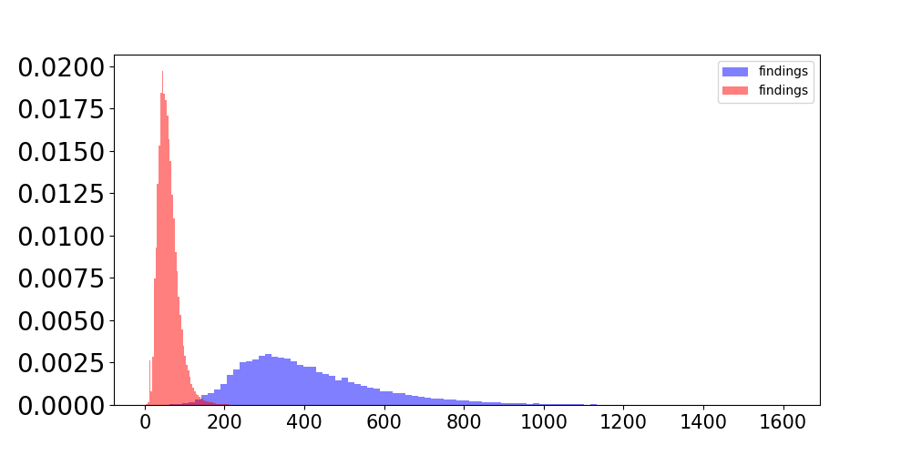
Introduction: What Makes Automatic PET Impression Generation Different?
Length
250-500 words in the findings section
CXR findings
Probability density
Whole-body PET findings
Word counts
Notes:
What makes PET reports different? First, whole-body PET reports are notable for their length. In the findings section, there are usually 250-500 words, which are 6-8 times longer than the typical findings for a CXR exam.

Slide 11
Introduction: What Makes Automatic PET Impression Generation Different?
Complexity
Observation across multiple anatomical regions
FINDINGS
Physiologic background liver standardized uptake value (SUV mean and SUV max) (…) Visualized head/neck: Physiologic uptake in the visualized portions of the brain (…) Head/neck lymph nodes: Interval decreased size and FDG activity (…)
-Right level IIb, 1.2 x 0.7 cm transaxially, SUV max 5.5, previously 1.6 x 0.7 cm, SUV max 6.2 (…) Lungs / Pleura / pericardium: No suspicious lung nodules or abnormal uptake. (…) Thoracic lymph nodes: Near complete resolution of supraclavicular/upper mediastinal (…)
Other chest findings: Physiologic myocardial uptake. Coronary artery calcifications. (…) Hepatobiliary: No abnormal uptake.. Spleen / Pancreas / Adrenals: No abnormal uptake. (…) Kidneys / bladder: No abnormal uptake. Physiologically excreted tracer activity (…) Bowel / peritoneum: No suspicious bowel uptake or abnormality. Pelvic organs: No abnormal uptake.. Abdominopelvic lymph nodes: Interval increased FDG uptake in an aortocaval lymph node (…)
Musculoskeletal / soft tissues / skin: No suspicious osseous lesions.
Notes:
It is also complex because PET findings usually contain observations across multiple anatomical regions, which increases the risk of omissions

Slide 12
Introduction: What Makes Automatic PET Impression Generation Different?
Unique reporting styles of individual reading physicians
Differences in Level of detail, inclusion criterion, phrasing, etc.
IMPRESSION dictated by Physician 1
IMPRESSION dictated by Physician 2
[1] FDG PET/CT demonstrates intensely FDG avid lymphadenopathy above and below the diaphragm involving the neck, chest, abdomen, and pelvis, as detailed in the findings, consistent with biopsy-proven mantle cell lymphoma (Deauville score 5).
[2] Marked splenomegaly with diffuse abnormal FDG activity, also suspicious for splenic lymphoma (Deauville 5).
Neck/thoracic/abdominopelvic nodal as well as splenic lymphoma (Deauville 5).
Notes:
In addition, the length of PET impressions can accentuate the unique reporting styles of individual reading physicians. For example, two physicians read the same report, but their impressions can be different in level of detail, inclusion criterion, and phrasing.

Slide 13
Purpose
Can LLMs accurately summarize PET findings and generate impressions suitable for clinical use?
Notes:
Given these challenges, we raised the question: can LLMs accurately summarize PET findings and generate impressions suitable for clinical use?

Slide 14
Dataset
37,370 retrospective PET reports from UW healthcare system between Jan 2010 and Jan 2023.
65 different physicians
Internal testing: 4000 reports
Training: 31,370 reports; Validation: 2000 reports
Notes:
Before delving into this questions, let me first introduce the dataset we used in this study. We collected roughly 37 thousand retrospective PET reports from our institution in the past 13 years and splitted them into the training, validation and testing sets.

Slide 15
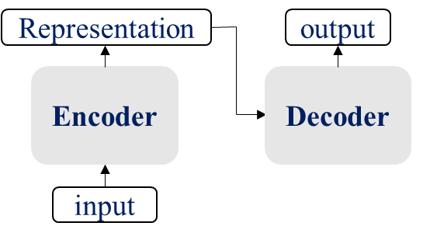
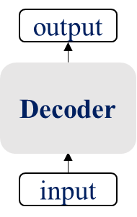
LLMs for PET Report Summarization
The SOTA encoder-decoder LLMs perform significantly better than decoder-only LLMs
>
e.g., BART, PEGASUS, T5
e.g., GPT2, LLaMA, Alpaca
Notes:
In our previous work, we investigated a broad range of open-sourced language models by finetuning them on our pet report corpus. we found that the SOTA encoder-decoder LLMs generally perform significantly better than the decoder-only LLMs.

Slide 16
LLMs for PET Report Summarization
The SOTA encoder-decoder LLMs perform significantly better than decoder-only LLMs
PEGASUS
Encoder-decoder LLM
Full fine-tuning
Achieve the highest scores across automatic evaluation metrics
>
e.g., BART, PEGASUS, T5
e.g., GPT2, LLaMA, Alpaca
Notes:
Among all 12 models we evaluated, PEGASUS achieved the highest scores across automatic evaluation metrics. So, we used it for the following expert evaluation. The detailed performance analysis can be found in our Arxiv paper. The link is provided at the end of the slide.

Slide 17
Personalized Impression Generation
An extra tag token encodes reading physician’s identity
Description: PET CT SKULL BASE TO THIGH.
Radiologist: James
Findings:
Physiologic background liver standardized uptake value (SUV mean and SUV max) reported for comparison between PET studies: (…)
Head/neck lymph nodes: No suspicious head/neck lymph nodes.
Lungs: Avid right upper lobe mass (…)
Pleura/pericardium: No pleural or pericardial effusion. (…)
Hepatobiliary: No abnormal uptake. Prior liver transplant. (…)
Pelvic organs: No abnormal uptake.
Abdominopelvic lymph nodes: No suspicious abdominopelvic lymph nodes.
Musculoskeletal/soft tissues/skin: No suspicious osseous lesions. (…)
Other: Aortoiliac atherosclerotic vascular calcifications. (…)
Indication:
[AGE] year old [SEX] with new diagnosis of right upper lobe nodule biopsy. (…)
LLM Impression in James’s style
[1] FDG PET/CT demonstrates an intensely FDG avid right upper lobe mass consistent with biopsy-proven primary lung malignancy.
[2] No evidence of other sites of abnormal FDG uptake to suggest locoregional or distant metastatic disease.
PEGASUS
Notes:
To allow models to generate personalized impressions matching individual physicians' reporting styles, we used an extra tag token to encode the reading physician’s identity. For example, if we give the token associated with one physician, the model should generate the impression in this physician’s style.

Slide 18
Personalized Impression Generation
An extra tag token encodes reading physician’s identity
Description: PET CT SKULL BASE TO THIGH.
Radiologist: Rachael
Findings:
Physiologic background liver standardized uptake value (SUV mean and SUV max) reported for comparison between PET studies: (…)
Head/neck lymph nodes: No suspicious head/neck lymph nodes.
Lungs: Avid right upper lobe mass (…)
Pleura/pericardium: No pleural or pericardial effusion. (…)
Hepatobiliary: No abnormal uptake. Prior liver transplant. (…)
Pelvic organs: No abnormal uptake.
Abdominopelvic lymph nodes: No suspicious abdominopelvic lymph nodes.
Musculoskeletal/soft tissues/skin: No suspicious osseous lesions. (…)
Other: Aortoiliac atherosclerotic vascular calcifications. (…)
Indication:
[AGE] year old [SEX] with new diagnosis of right upper lobe nodule biopsy. (…)
LLM Impression in Rachael’s style
PEGASUS
Right upper lobe primary lung malignancy without evidence of nodal or distant metastases.
Notes:
If we change this token, we can instruct the model to generate impressions that align with another physician’s reporting style.

Slide 19
Expert Reader Study
Three NM physicians reviewed 72 whole-body PET reports
PEGASUS impressions
Each physician independently reviewed 24 cases
12 their own reports, 12 other physicians’ reports
Notes:
To answer the question whether the LLM impressions are clinically useful or not, we conducted a reader study. 3 NM physicians reviewed 72 whole-body PET reports and scored both original clinical impressions and PEGASUS-generated impressions.
Each physician independently reviewed 24 cases, with 12 cases dictated by themselves and 12 dictated by other physicians. During the evaluation, the readers were blinded to the original interpreting physician’s identity.

Slide 20
Expert Reader Study
Scoring system
Six quality dimensions (3-point scale, 3 best, 1 worst) and an overall utility score (5-point scale, 5 best, 1 worst)
Evaluation Category | Definition
Additions | The impression is not repetitive and does not include unnecessary findings.
Omissions | The impression contains all important findings.
Factual correctness | The impression accurately represents the findings and is devoid of factual errors.
Clarity and organization | The impression is unambiguous, grammatical, and well-organized.
Interpretive and technical jargon | The impression provides appropriate interpretations of the findings and avoids using unnecessary radiologic jargon or details.
Recommendations | The recommendations for patient management, if applicable, are clinically valid.
Overall utility score | Given the impression as an initial draft, consider how many changes would you make to render it suitable for clinical use.
Notes:
The scoring system includes 6 quality dimensions and an overall utility score. Six quality dimensions are additions, omissions, factual correctness, clarity and organization, interpretive and technical jargon, and recommendations. for overall utility, scores of 3 or above are clinically acceptable.

Slide 21
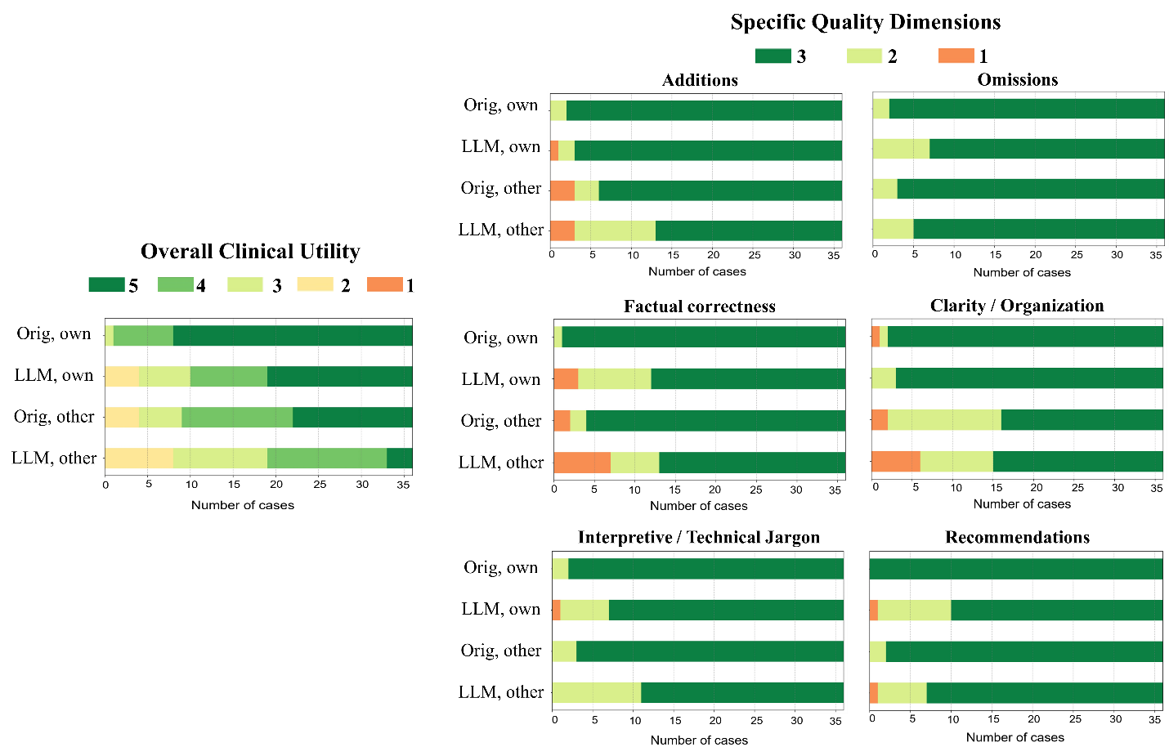
Results: Overall Utility Scores
Overall Clinical Utility
Orig, own
4.75
LLM, own
4.08
Orig, other
4.03
LLM, other
3.33
0
5
10
15
20
25
30
35
Number of cases
Notes:
This slide shows the distribution of overall utility scores given by physicians. The numbers right next to the figure are mean utility scores for each group.

Slide 22
Results: Overall Utility Scores
Overall Clinical Utility
Orig, own
4.75
LLM, own
4.08
In total, 83% of the PEGASUS-generated impressions were scored as clinically acceptable (scores 3-5)
Orig, other
4.03
LLM, other
3.33
0
5
10
15
20
25
30
35
Number of cases
Notes:
In total, 83% of the PEGASUS-generated impressions were scored as clinically acceptable

Slide 23
Results: Overall Utility Scores
Overall Clinical Utility
Orig, own
4.75
LLM, own
4.08
Personalized LLM impressions are comparable to the clinical impressions dictated by other physicians
Orig, other
4.03
LLM, other
3.33
0
5
10
15
20
25
30
35
Number of cases
Notes:
Interestingly, on average, physicians considered the overall utility of personalized LLM impressions to be comparable to the impressions dictated by other physicians.

Slide 24
Results: Overall Utility Scores
Overall Clinical Utility
Orig, own
4.75
LLM, own
4.08
Personalized LLM impressions have not reached the utility of clinical impressions dictated by the physician themselves
Orig, other
4.03
LLM, other
3.33
0
5
10
15
20
25
30
35
Number of cases
Notes:
However, we still observe the discrepancy between physicians’ own impressions and personalized PEGASUS impressions.

Slide 25
Results: Primary Reasons for Discrepancy
Overall Clinical Utility
 | Clinical impressions | LLM impressions
Additions | 2.94 | 2.89
Omissions | 2.94 | 2.81
Factual correctness | 2.97 | 2.58
Clarity and Organization | 2.92 | 2.92
Interpretive and technical jargon | 2.94 | 2.78
Recommendations | 3.00 | 2.69
Orig, own
4.75
LLM, own
4.08
Orig, other
4.03
LLM, other
3.33
0
5
10
15
20
25
30
35
Number of cases
Notes:
To find the primary reasons for the discrepancy, we calculated their average scores along each quality dimension. The underline indicates the statistically significant difference. We notice that the main causes include factual incorrectness, inappropriate interpretations and unsuitable recommendations. Later on, I will show you how these problems manifest in the generated impressions.

Slide 26
Results: Sample Case #1
PEGASUS-personalized Impression
Overall utility score = 5
Original Clinical Impression
[1] FDG PET/CT demonstrates short-term stability of the solitary nodule within the right upper lobe, which has only minimal associated FDG uptake, not elevated above mediastinal blood pool. Given the lack of significant FDG avidity, and the suggestion of macroscopic fat within the nodule on prior diagnostic chest CT, a benign lesion such as a pulmonary hamartoma is a consideration. Could consider short-term follow-up diagnostic CT chest in 3-6 months to assess for interval change. [2] No evidence of suspected FDG avid local nodal mediastinal/hilar or distant metastatic disease. [3] Mildly lobulated nodular soft tissue in the subareolar right breast, without significant FDG avidity. Could correlate with prior mammography, if available. If not, screening mammography is recommended. | [1] FDG PET/CT demonstrates a 1.2 x 1.3 cm subpleural solid nodule within the anteroinferior right upper lobe with mild associated FDG uptake, which is nonspecific by PET criteria for an infectious/inflammatory process versus low-grade primary lung malignancy. Recommend correlation with prior and/or follow-up thoracic CT to assess for interval change in size. [2] No evidence of FDG avid local nodal mediastinal/hilar or distant metastatic disease. [3] Redemonstration of a mildly lobulated nodular area of soft tissue within the subareolar right breast, unchanged compared to [DATE]. This does not appear to have associated hypermetabolic activity.
Notes:
In this case, the PEGASUS impression on the right captured all critical findings. Many cases just look like this. But we would like to focus more on the mistakes committed by the LLM.

Slide 27
Results: Sample Case #2
PEGASUS-personalized Impression
Overall utility score = 2
Original Clinical Impression
[1] FDG PET/CT demonstrates intense FDG activity associated with the area of nodular soft tissue thickening at the posterior aspect of the left breast, highly suspicious for recurrent/residual malignancy. [2] Intense FDG avidity associated with the left axillary lymphadenopathy, which is overall unchanged in size and distribution compared to the recent [DATE] CT, also highly suspicious for persistent nodal metastatic disease. [3] No definite evidence of FDG avid osseous metastatic disease. Mild heterogeneous FDG activity, similar to normal bone marrow activity, corresponding to mottled sclerotic and lytic changes in the pelvis, lumbar spine and T8 vertebral body, most likely represents physiologic bone marrow activity at sites of previously treated osseous metastatic disease. | [1] FDG PET/CT demonstrates intense FDG activity associated with the enlarging nodular soft tissue at the posterior aspect of the left breast glandular tissue, which appears to be enlarging on previous CT examinations. This finding is highly suspicious for recurrent malignancy. [2] Moderate-intense FDG avid left axillary lymphadenopathy, similar in size and distribution compared to recent chest CT from [DATE], compatible with nodal metastatic disease. [3] Heterogeneous mild to moderate FDG uptake associated with sclerotic and lytic osseous changes in the pelvis, left clavicle, and T8 vertebral body, with no definite correlative CT bone abnormality on our corresponding low-dose noncontrast CT. These findings are nonspecific but favored to represent posttreatment related inflammatory change rather than residual/recurrent disease. Recommend attention to these sites on follow-up imaging. [4] No evidence of FDG-avid distant metastatic disease in the chest, abdomen, or pelvis.
Factual inaccuracy
Notes:
For this one, the main problem with the PEGASUS impression is located at impression 4. It says no metastatic disease in the chest, but this patient indeed has nodal metastasis in the chest. As you can see in bullet point [2].

Slide 28
Results: Sample Case #3
PEGASUS-personalized Impression
Overall utility score = 2
Original Clinical Impression
[1] FDG PET/CT demonstrates a moderately hypermetabolic spiculated right upper lobe lung nodule which is nonspecific by PET and would be compatible with biopsy-proven atypical adenomatous hyperplasia. Of note, the medial aspect of this nodule has more prominent FDG uptake and may high-grade malignancy; recommend correlation with biopsy site and consider repeat biopsy at this location as clinically indicated. Recommend close serial interval follow-up with thoracic CT. [2] Mild to moderately hypermetabolic mildly enlarged bilateral paratracheal, hilar, and subcarinal lymphadenopathy. Mild to moderately hypermetabolic bilateral right greater than left level IV, VI and supraclavicular lymphadenopathy. These nodes are favored to be secondary to diagnosed chronic lymphocytic leukemia although reactive lymph nodes secondary to recent pneumonia can also be considered. However, there are no abnormally FDG avid lymph nodes to suggest Richter's transformation. If tissue sampling is desired for clinical decision making, right hilar nodes should be targeted. (…) | [1] FDG PET/CT demonstrates moderate FDG uptake in the medial aspect of the spiculated right upper lobe lung nodule which is stable in size and appearance from recent CT chest from [DATE]. This finding is suspicious for primary lung malignancy although an infectious/inflammatory process cannot be completely excluded. Recommend clinical correlation and consider tissue sampling for further evaluation as clinically indicated. [2] Mild to moderately hypermetabolic enlarged bilateral paratracheal, hilar, and subcarinal nodes, as detailed in the findings, which are suspicious for nodal metastatic disease. (…)
Missing supraclavicular and level IV and VI cervical LNs
Notes:
This is another case with some problems. The first one is missing several lymphoma nodes with hypermetabolic activity .

Slide 29
Results: Sample Case #3
PEGASUS-personalized Impression
Overall utility score = 2
Original Clinical Impression
[1] FDG PET/CT demonstrates a moderately hypermetabolic spiculated right upper lobe lung nodule which is nonspecific by PET and would be compatible with biopsy-proven atypical adenomatous hyperplasia. Of note, the medial aspect of this nodule has more prominent FDG uptake and may high-grade malignancy; recommend correlation with biopsy site and consider repeat biopsy at this location as clinically indicated. Recommend close serial interval follow-up with thoracic CT. [2] Mild to moderately hypermetabolic mildly enlarged bilateral paratracheal, hilar, and subcarinal lymphadenopathy. Mild to moderately hypermetabolic bilateral right greater than left level IV, VI and supraclavicular lymphadenopathy. These nodes are favored to be secondary to diagnosed chronic lymphocytic leukemia although reactive lymph nodes secondary to recent pneumonia can also be considered. However, there are no abnormally FDG avid lymph nodes to suggest Richter's transformation. If tissue sampling is desired for clinical decision making, right hilar nodes should be targeted. (…) | [1] FDG PET/CT demonstrates moderate FDG uptake in the medial aspect of the spiculated right upper lobe lung nodule which is stable in size and appearance from recent CT chest from [DATE]. This finding is suspicious for primary lung malignancy although an infectious/inflammatory process cannot be completely excluded. Recommend clinical correlation and consider tissue sampling for further evaluation as clinically indicated. [2] Mild to moderately hypermetabolic enlarged bilateral paratracheal, hilar, and subcarinal nodes, as detailed in the findings, which are suspicious for nodal metastatic disease. (…)
Misinterpret the finding as metastatic disease
Notes:
The second one is LLM impression misinterprets the findings as metastatic disease. However, this finding is more favored to malignant chronic lymphocytic [limf’s /ai/ tik] leukemia (CLL).

Slide 30
Results: Sample Case #3
PEGASUS-personalized Impression
Overall utility score = 2
Original Clinical Impression
[1] FDG PET/CT demonstrates a moderately hypermetabolic spiculated right upper lobe lung nodule which is nonspecific by PET and would be compatible with biopsy-proven atypical adenomatous hyperplasia. Of note, the medial aspect of this nodule has more prominent FDG uptake and may high-grade malignancy; recommend correlation with biopsy site and consider repeat biopsy at this location as clinically indicated. Recommend close serial interval follow-up with thoracic CT. [2] Mild to moderately hypermetabolic mildly enlarged bilateral paratracheal, hilar, and subcarinal lymphadenopathy. Mild to moderately hypermetabolic bilateral right greater than left level IV, VI and supraclavicular lymphadenopathy. These nodes are favored to be secondary to diagnosed chronic lymphocytic leukemia although reactive lymph nodes secondary to recent pneumonia can also be considered. However, there are no abnormally FDG avid lymph nodes to suggest Richter's transformation. If tissue sampling is desired for clinical decision making, right hilar nodes should be targeted. (…) | [1] FDG PET/CT demonstrates moderate FDG uptake in the medial aspect of the spiculated right upper lobe lung nodule which is stable in size and appearance from recent CT chest from [DATE]. This finding is suspicious for primary lung malignancy although an infectious/inflammatory process cannot be completely excluded. Recommend clinical correlation and consider tissue sampling for further evaluation as clinically indicated. [2] Mild to moderately hypermetabolic enlarged bilateral paratracheal, hilar, and subcarinal nodes, as detailed in the findings, which are suspicious for nodal metastatic disease. (…)
Non-specific or missing recommendations
Notes:
The last problem is nonspecific or missing recommendations. Some of the recommendations can be too general, such as recommend clinical correlation rather than detailed guidance for patient management.
Skip:
It is important to note that the diagnoses and recommendations are typically not included in the findings, the language models must infer based on those critical observations they find.

Slide 31
Summary
In the expert reader study, the large majority of the LLM impressions were scored clinically acceptable.
Three physicians considered the overall utility of personalized LLM impressions to be comparable to clinical impressions dictated by other physicians.
Primary reasons for discrepancy between personalized LLM impressions and physicians’ own impressions
Factual inaccuracy
Inappropriate interpretations
Non-specific recommendations
Notes:
The quality of LLM impression is great but of course not perfect. The common mistakes we identified for LLMs include factual inaccuracy, inappropriate interpretations and non-specific recommendations.

Slide 32




Thank you
xtie@wisc.edu
Notes:
If you are interested in our work, you can find our arxiv paper by scanning the QR code on the left.

